Slide 1
FGCT5004: Mocap Elective
Piper Cadence Crow, Student No: 2311323
January
2026

Slide 2
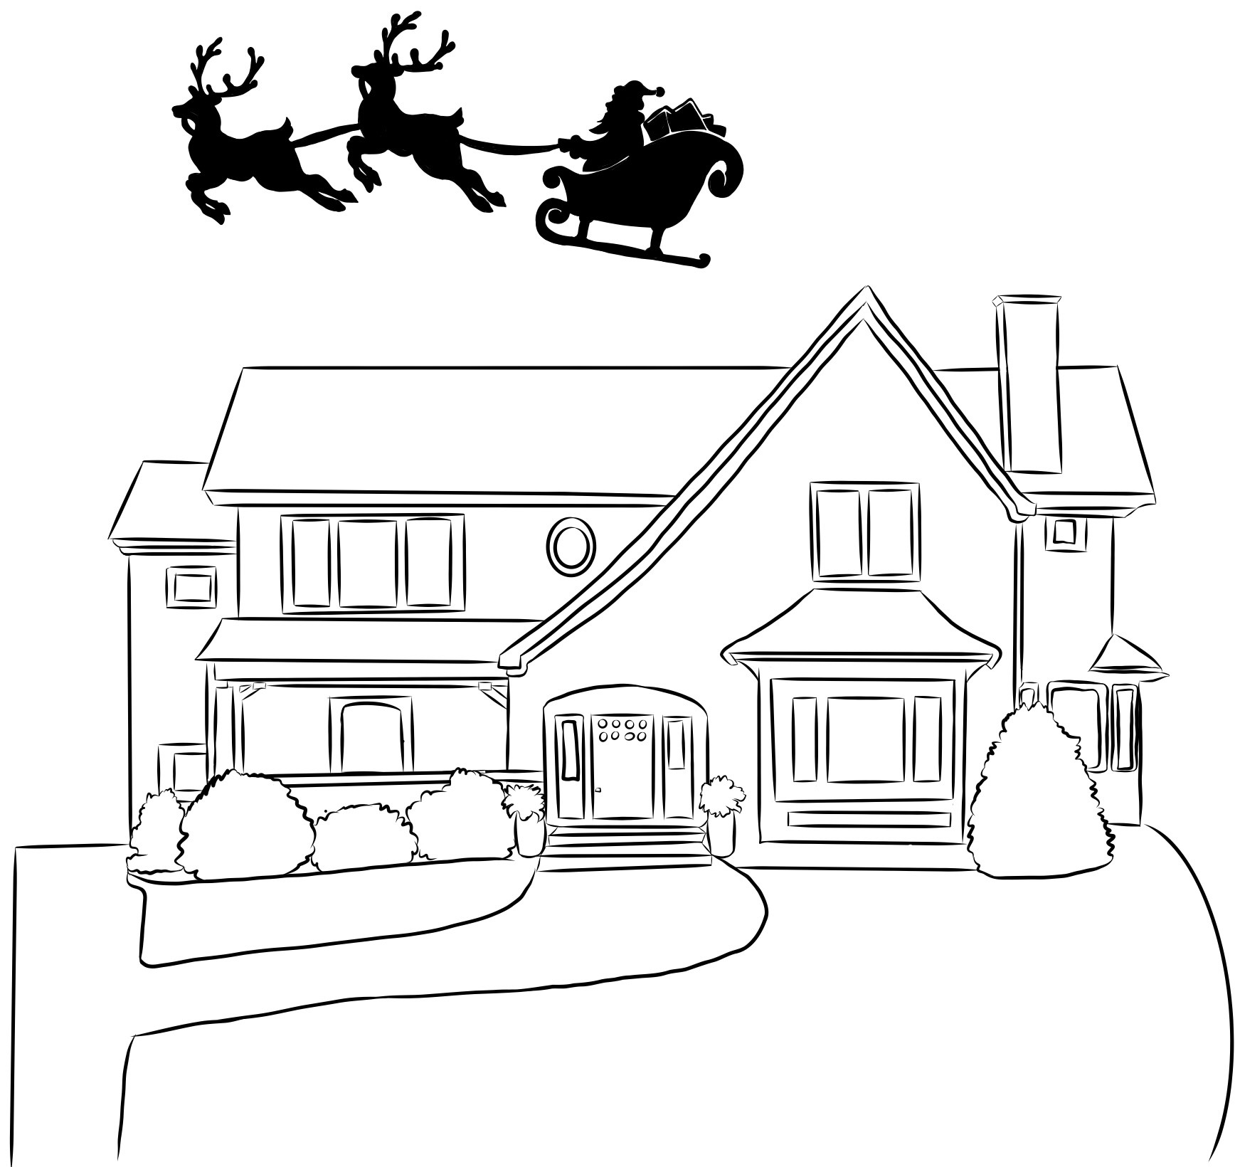
Story Board
Cutscene 01 (0-5s)

Slide 3
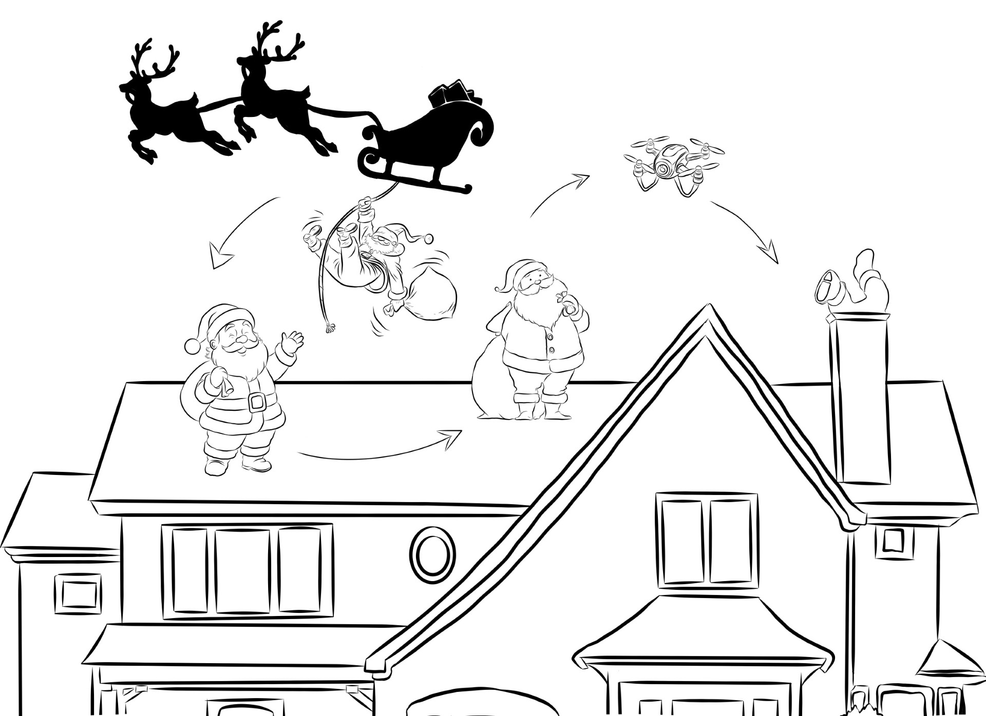
Story Board
Cutscene 01 (5-15s)

Slide 4
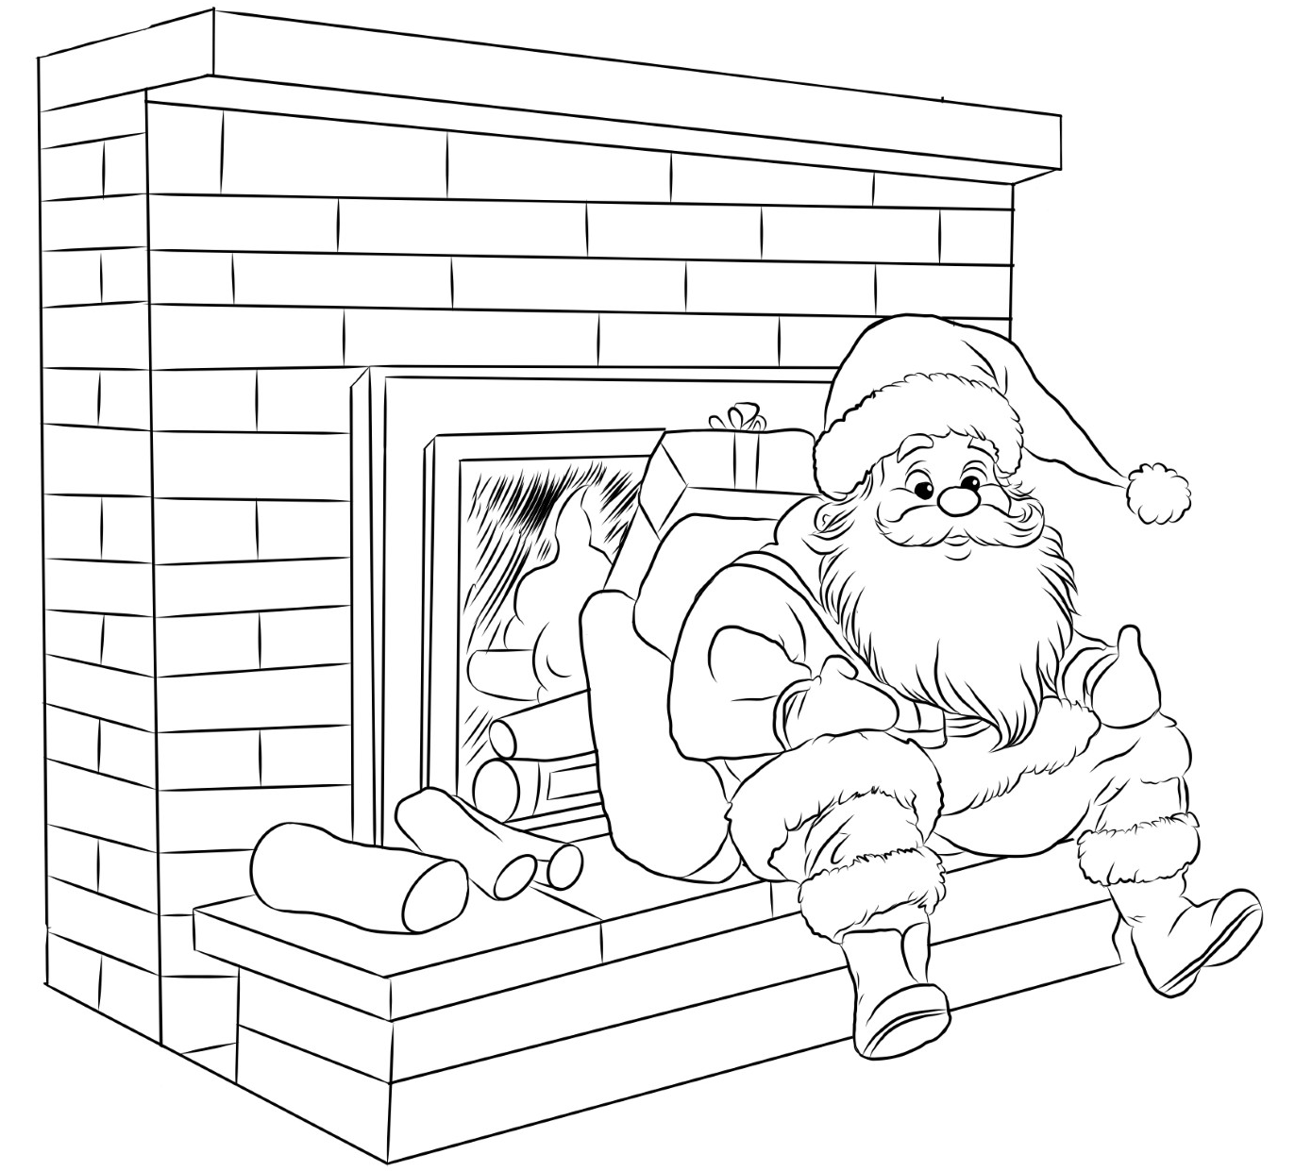
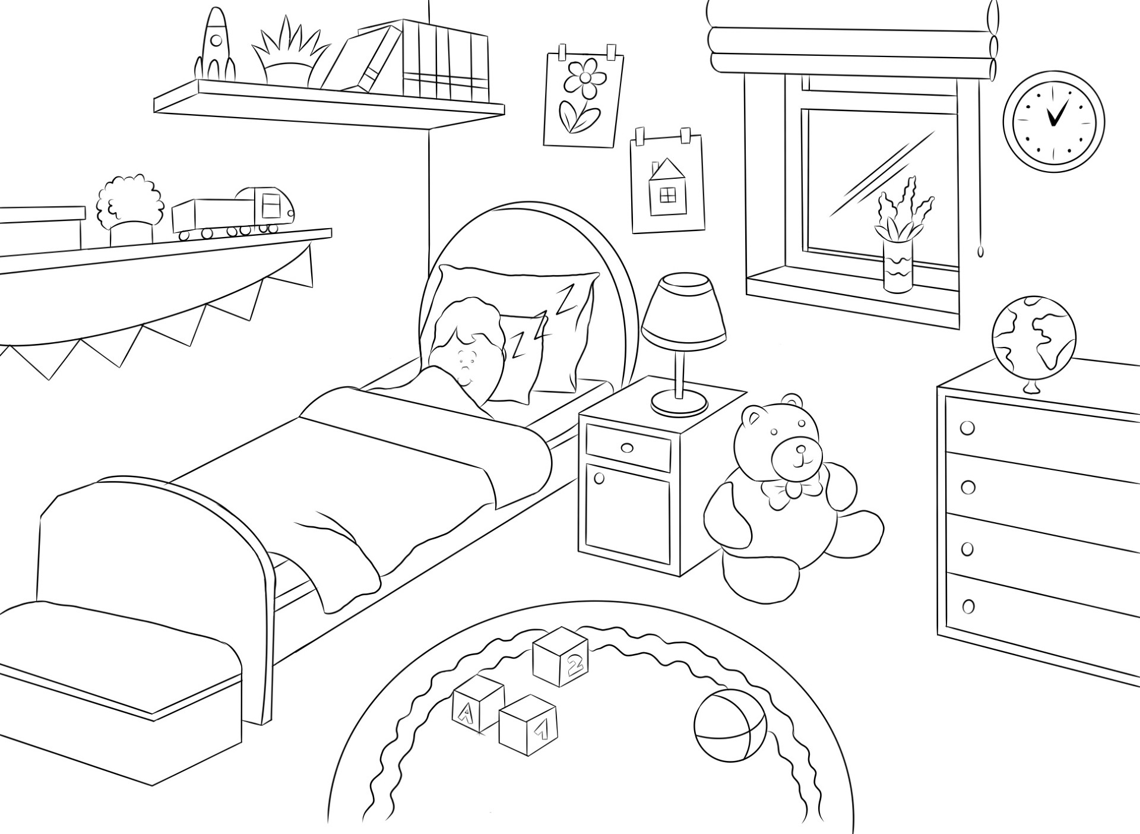
Story Board
Cutscene 02 (15-25s)
Cutscene 02 (25-30s)

Slide 5
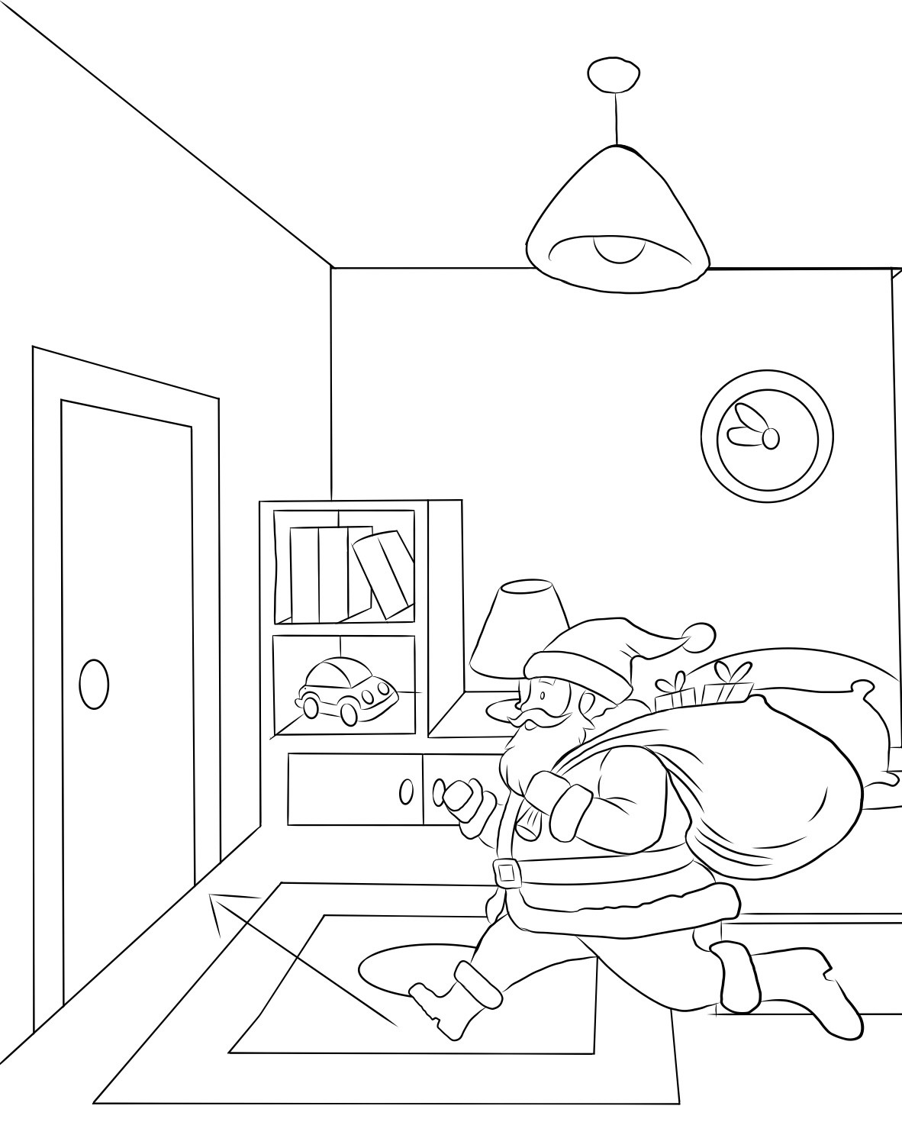
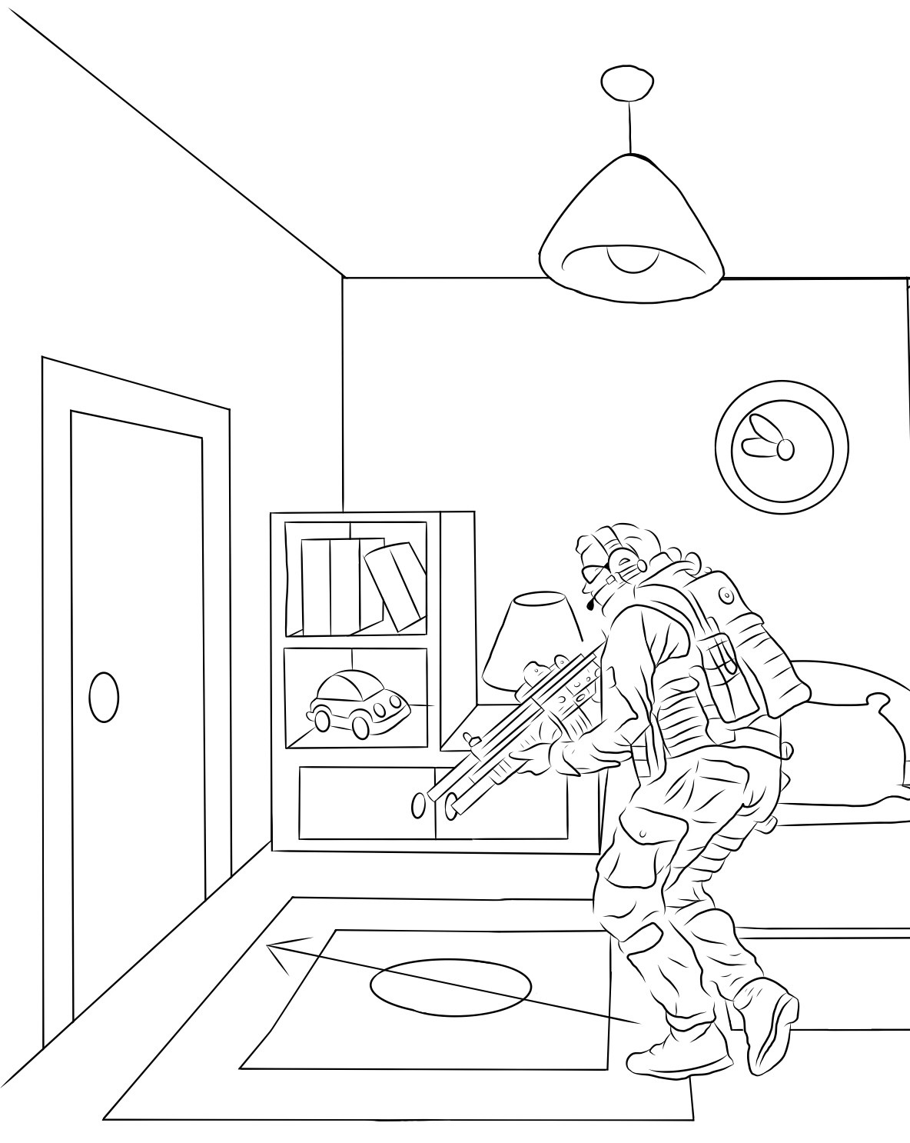
Story Board
Cutscene 03 (30-50s)
Cutscene 04 (50-55s)

Slide 6
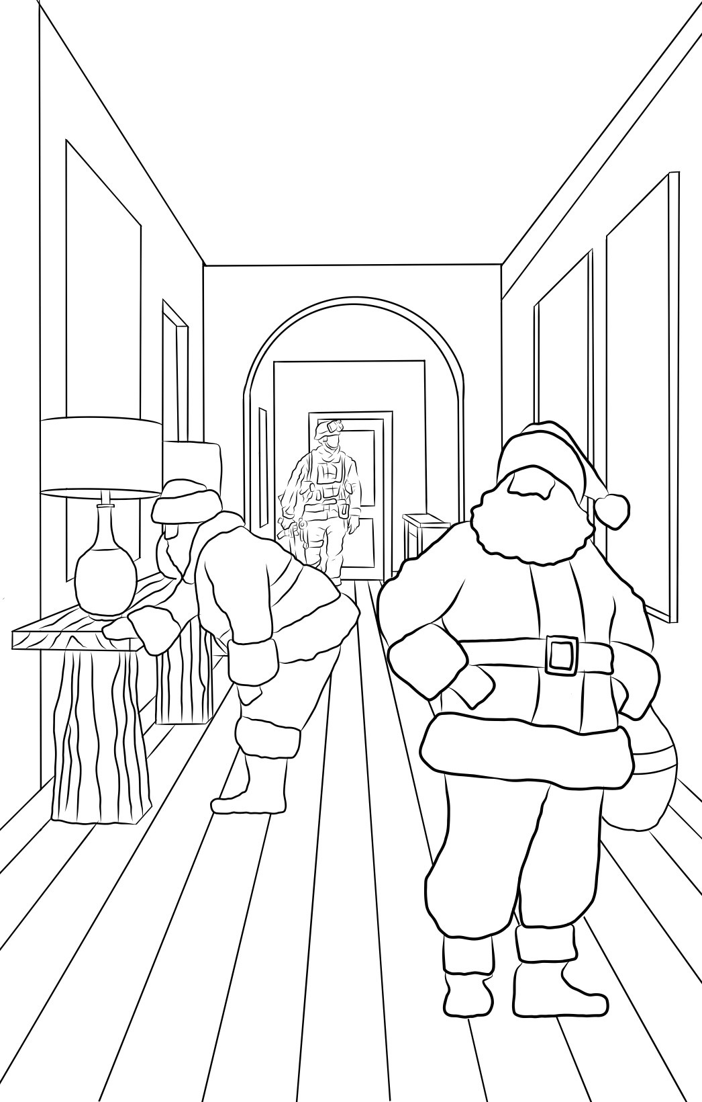
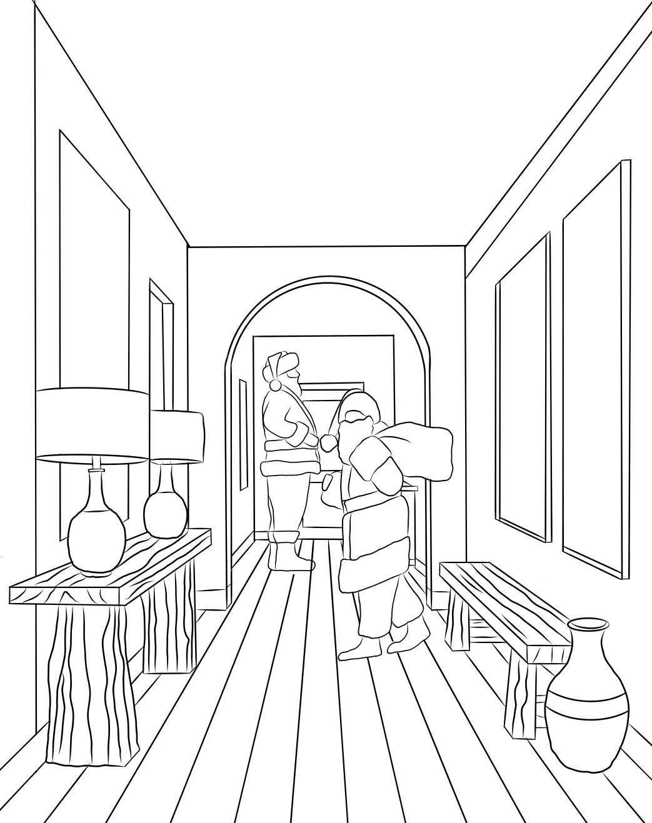
Story Board
Cutscene 04 (55-60s)
Cutscene 04 (60-65s)

Slide 7
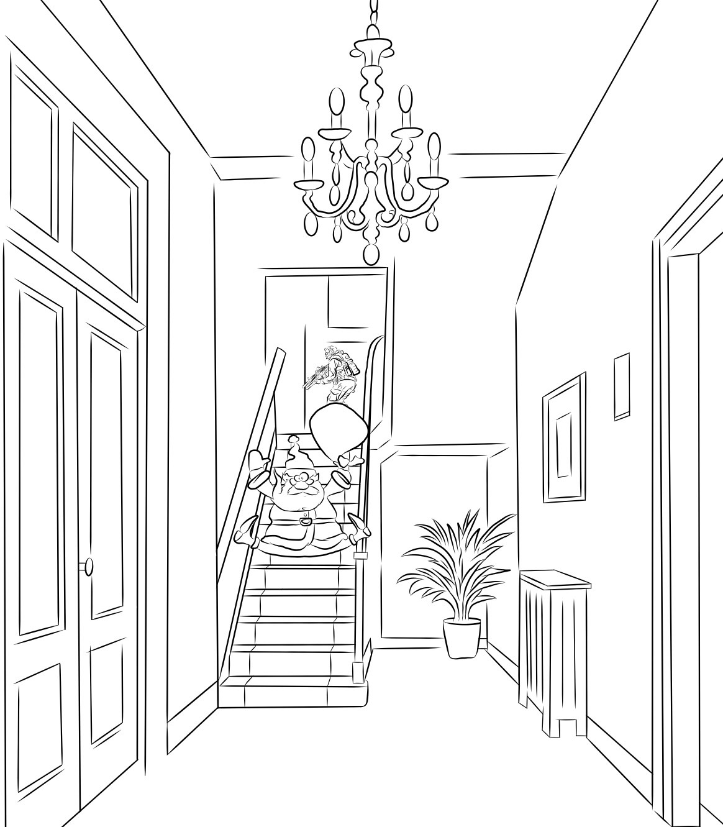
Story Board
Cutscene 05 (65-75s)

Slide 8
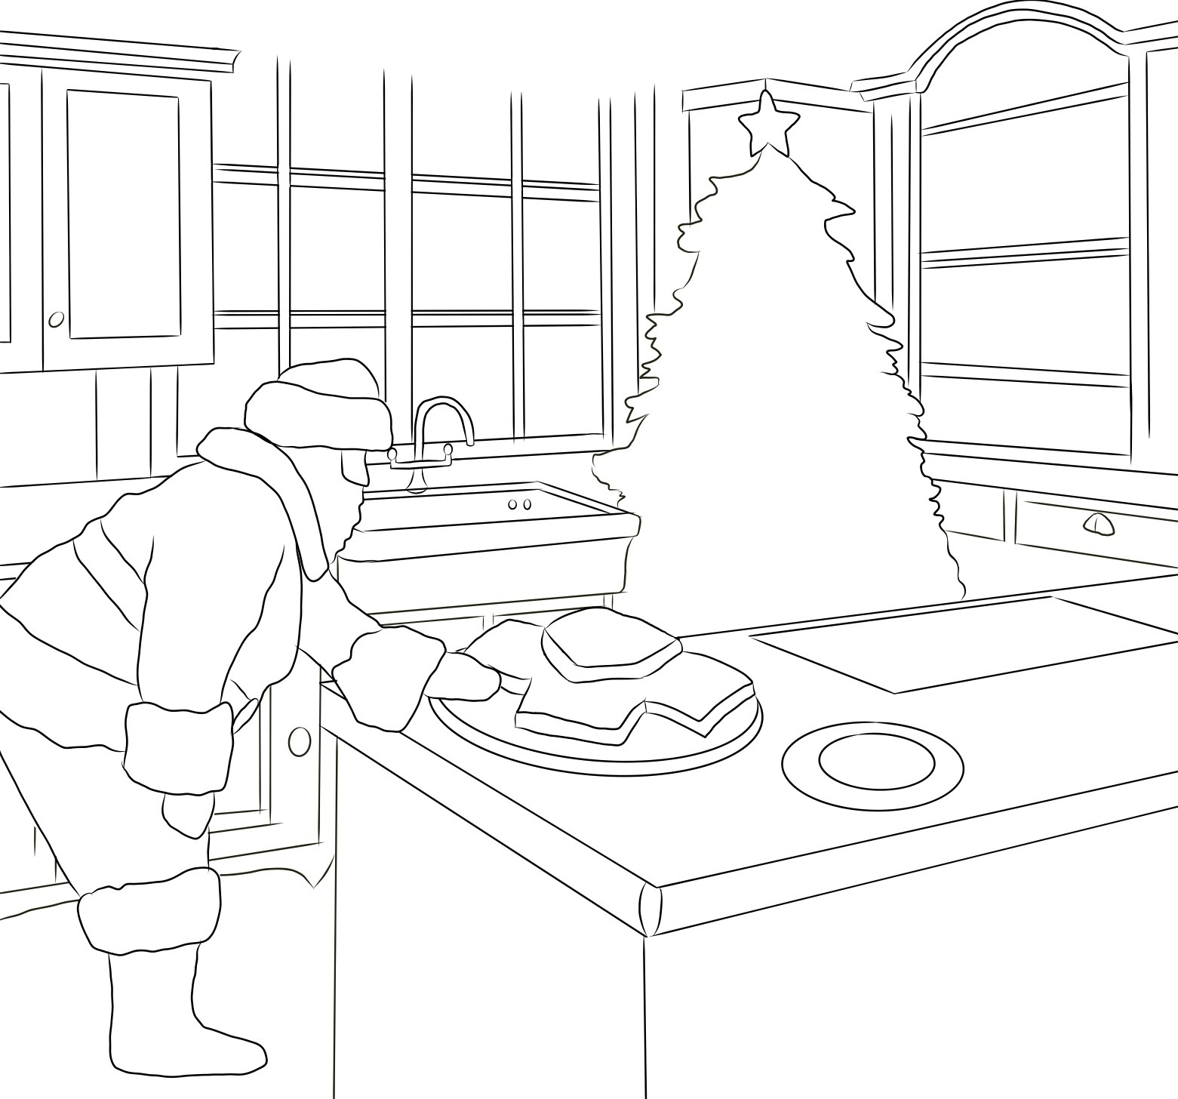
Story Board
Cutscene 06 (75-90s)

Slide 9
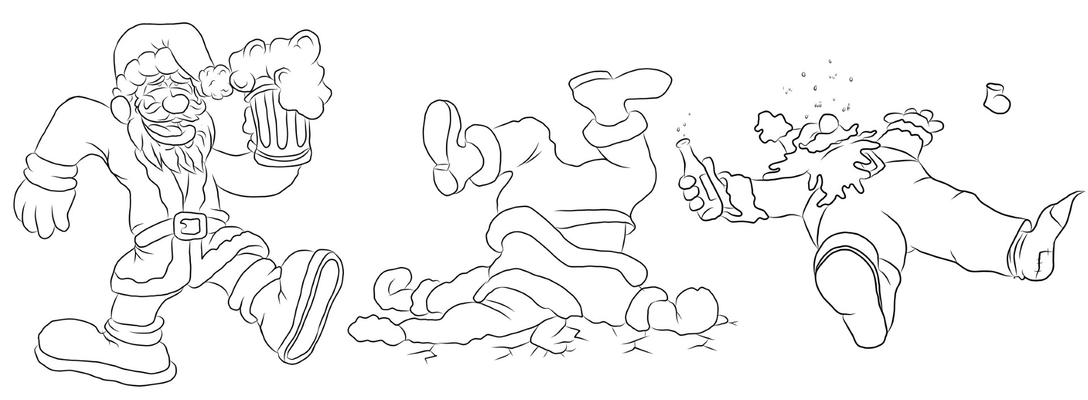
Story Board
Cutscene 07 (90-100s)

Slide 10
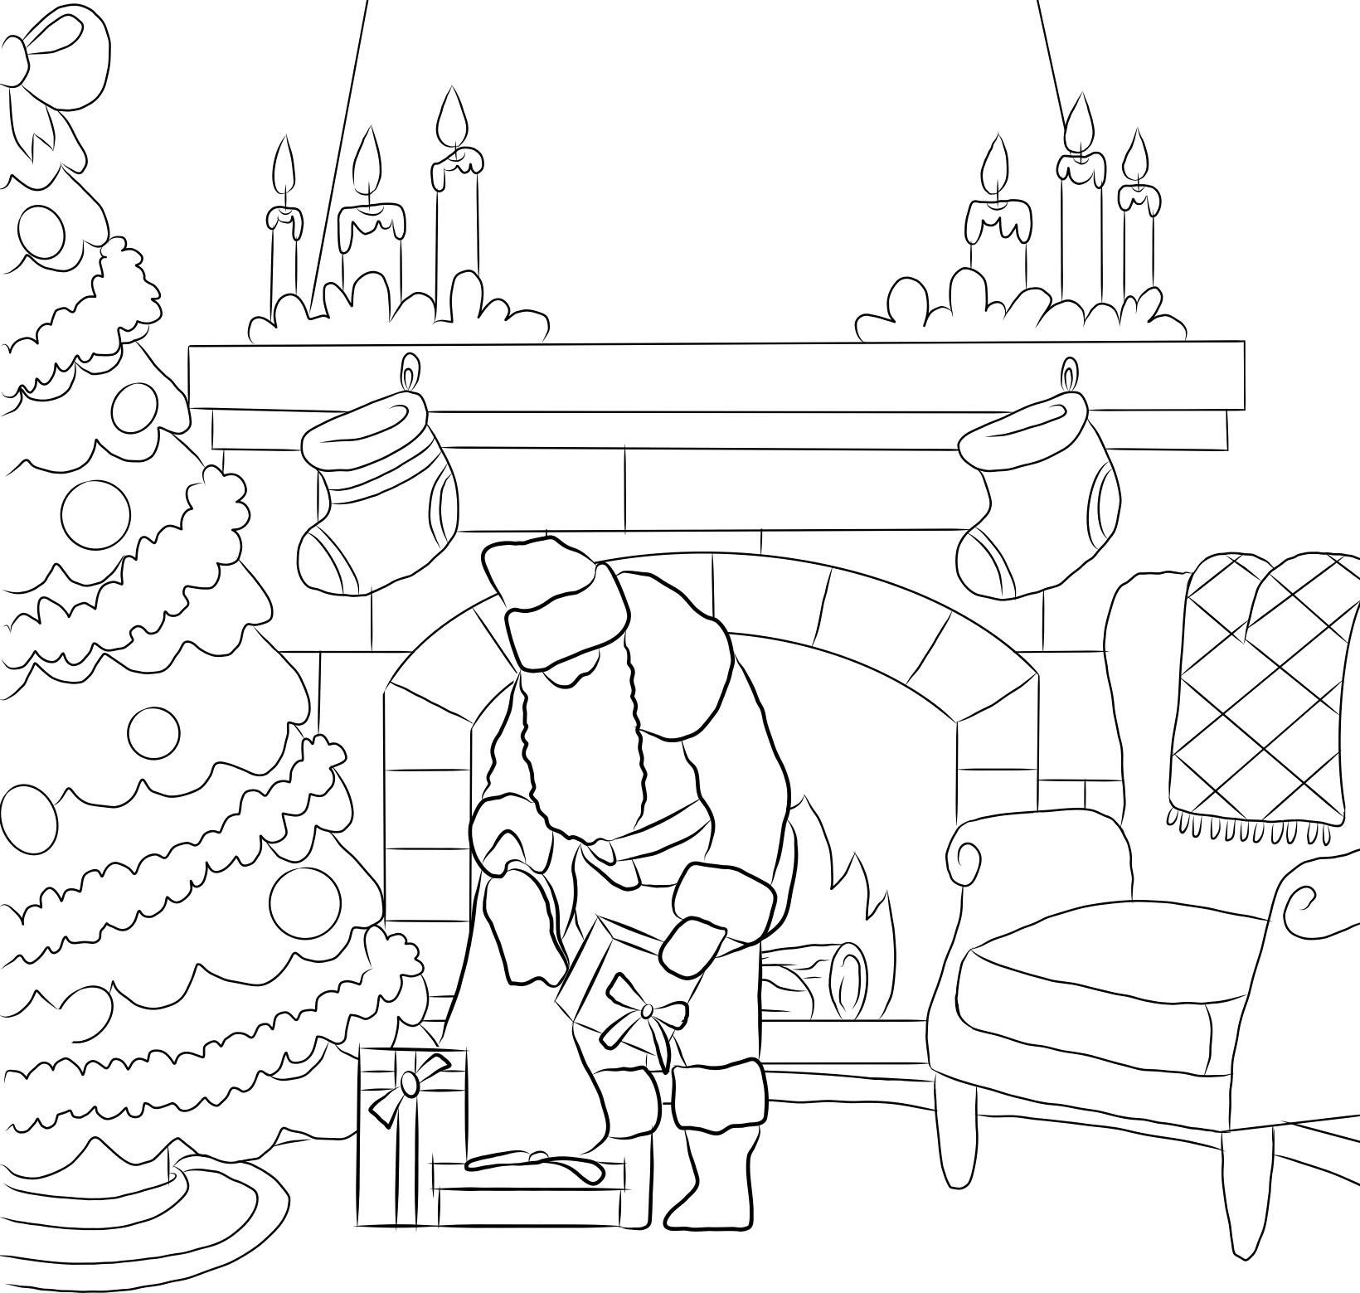
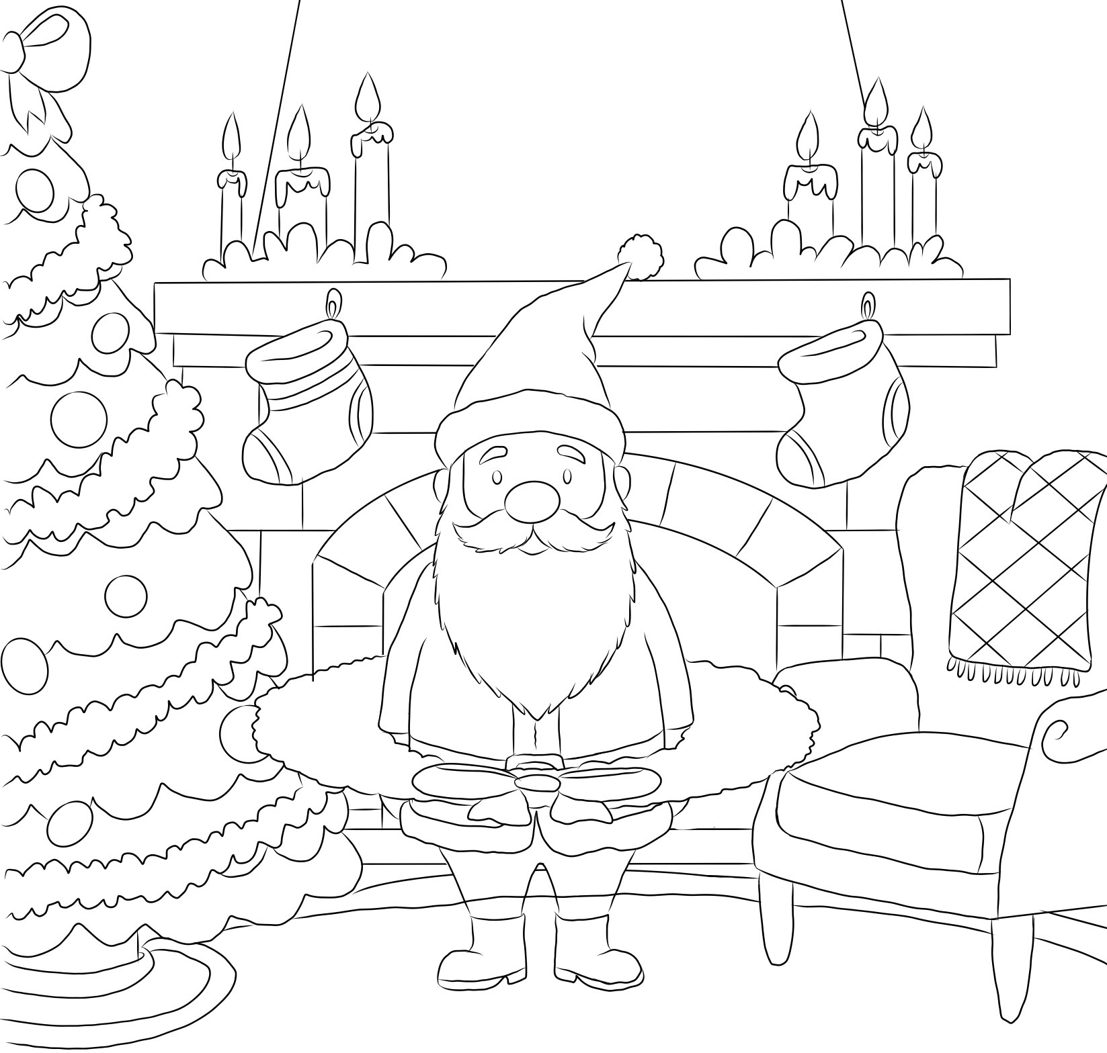
Story Board
Cutscene 08 (100-110s)
Cutscene 08 (110-120s0

Slide 11
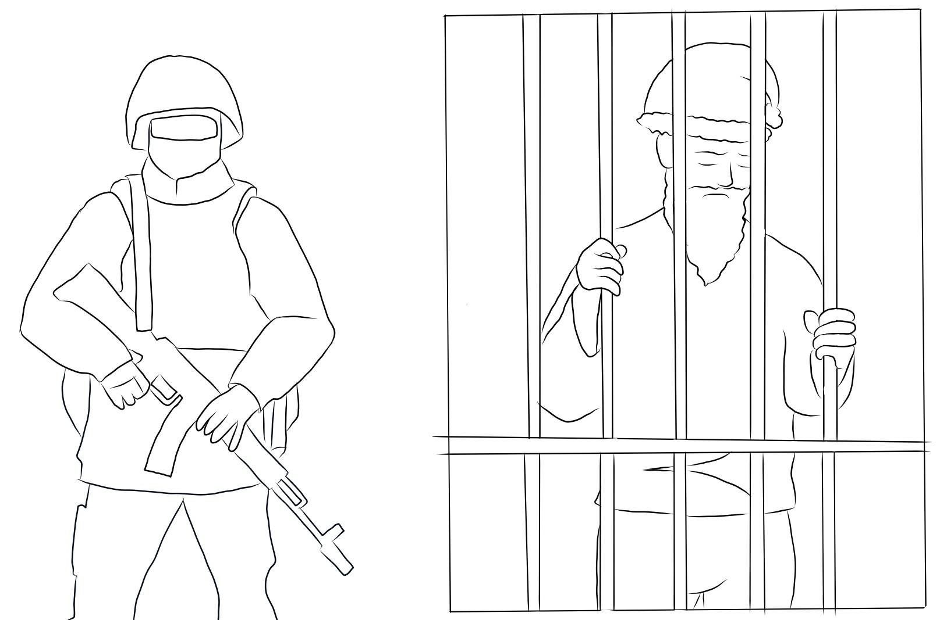
Story Board
Cutscene 09 (120-135s)

Slide 12
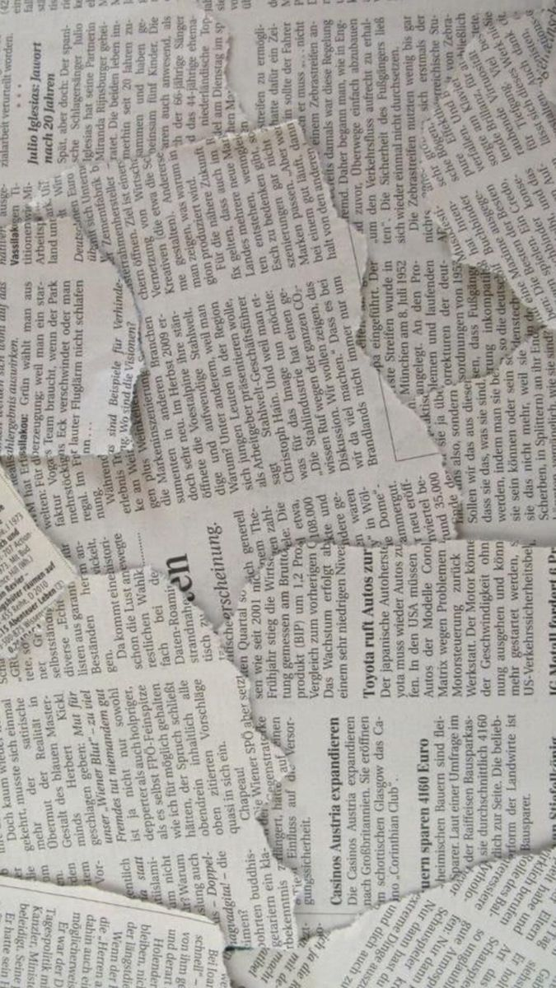
Breakdown of Cutscene
Storyboard Cutscene (approx. 1:35-1:40 Minutes)
[0-5s]
Camera: Wide establishing shot of a quiet suburban house under a starry night sky. Audio: Soft wind, distant city ambience, faint sleigh bells approaching.
[5-10s]
Camera: Tilt down as Santa drops from the sleigh, landing awkwardly in the snow. Action: Santa stumbles slightly, bells jingle on impact. Audio: Heavy thud, sleigh bells.
[10-15s]
Camera: Medium shot as Santa brushes himself off and walks toward the chimney. Action: A security drone slowly passes through frame behind him. Audio: Low electronic hum from the drone.
[15-20s]
Camera: Interior shot looking up the chimney. Action: Santa drops suddenly into frame and crashes onto the bedroom floor. Audio: Loud crash, soot settling.
[20-25s]
Camera: Close-up of Santa on the floor. Dialogue: Santa (softly): “Oh, snowballs…” Action: He stands, brushing soot off his coat.
[25-30s]
Camera: Over-the-shoulder shot revealing a “sleeping” child in bed. Audio: Soft breathing, room ambience.

Slide 13
Breakdown of Cutscene
[30-35s]
Camera: Low-angle tracking shot of Santa’s boots stepping onto scattered toys. Action: He nearly slips. Audio: Plastic toy squeaks.
[35-40s]
Camera: Medium shot of Santa tiptoeing. Dialogue: Santa (muttering): “Would it kill this kid to clean up a little?”
[40-45s]
Camera: Close-up of Santa wobbling. Dialogue: Santa (whispering): “Should’ve been on the naughty list.”
[45-50s]
Camera: Medium shot as Santa exits the bedroom into the hallway.
[50-55s]
Camera: Slow push-in on the bed. Action: The “child” rises silently, revealing a military man. Audio: Subtle fabric movement.
[55-60s]
Camera: Shadowed hallway shot as the soldier follows Santa. Action: Stealthy footsteps.
[60-65s]
Camera: Close-up of Santa’s foot landing on a bauble at the top of the stairs. Audio: Glass clink.

Slide 14
Breakdown of Cutscene
[65-75s]
Camera: Wide shot down the staircase as Santa tumbles end over end. Action: Limbs flailing, sack flying open slightly. Audio: Thuds, crashes, ornaments breaking.
[75-80s]
Camera: Medium shot of Santa pulling himself upright in the kitchen. Action: He spots milk and cookies on the counter.
[80-85s]
Camera: Close-up of Santa grabbing a cookie. Dialogue: Santa: “Thank God it’s my cheat day, or the Mrs. would have my beard.”
[85-90s]
Camera: Time-lapse style cut or quick montage of Santa eating. Action: His movements gradually slow.
[90-95s]
Camera: Close-up on Santa gripping the counter, vision blurring. Action: He sways. Audio: Ringing sound effect.
[95-100s]
Camera: Medium shot as Santa stumbles into the living room.
[100-105s]
Camera: Warm-lit shot of the Christmas tree. Dialogue: Santa: “Finally… I can get out of this house.”

Slide 15
Breakdown of Cutscene
[105-110s]
Camera: Low angle of Santa placing presents aggressively. Dialogue: Santa: “Coal for everyone in this awful house…”
[110-115s]
Camera: Close-up of wire tightening around Santa’s ankle. Dialogue: Santa: “What the elf?!”
[115-120s]
Camera: Overhead shot as a wreath drops and traps him. Action: Santa struggles, vision blurs.
[120-125s]
Camera: Fade in from black. Close-up of Santa’s face waking up. Audio: Low mechanical hum.
[125-130s]
Camera: Slow pull-back revealing Santa behind jail bars. Action: Alien silhouettes visible.
[130-135s]
Camera: Extreme wide shot of Area 51 cell block. Dialogue: Santa: “Ho ho ho… oh no…”

